Slide 1
Deadlock handling & two-phase commit protocol

Slide 2
Sardar Vallabhbhai Institute of Technology
Group: Anand chauhan (217ITBEG012)
Hitesh Solanki (217BEIT012)
Nirali Vavasa (217BEIT014)
Ajay bavariya (217ITBEG016)
Field: Information Technology
Sub : Database management System(2130703)

Slide 3
What is deadlock ?
A process request the resources , the resources are not available at that time , so the process enter into the waiting state. The requesting resources are held by another waiting process , both are in waiting state , this situation is called as deadlock.

Slide 4
Types of Resources :
Reusable : Used by only one process at a time and is not depleted by that use.
consumable : Can be created and destroy

Slide 5
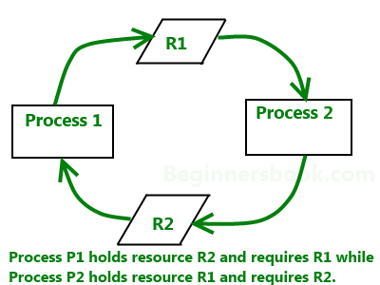
Deadlock

Slide 6
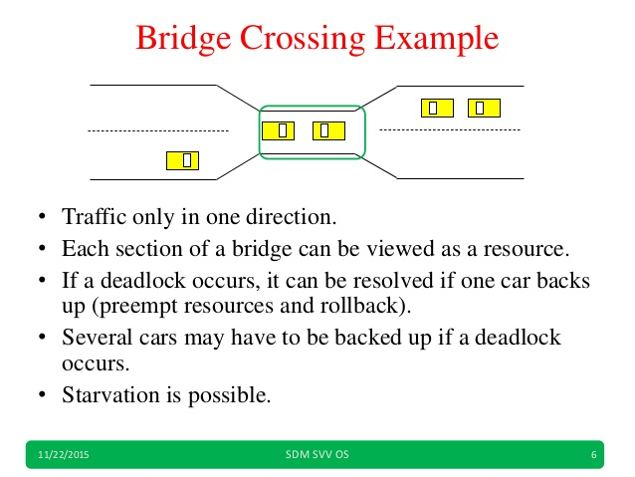
Example of deadlock

Slide 7
Deadlock characterization
Deadlock can arise if hour condition hold simultaneously :-
Mutual exclusion : Only one process may use a resources at a time.
Hold and Wait : A process holding at least one resource is waiting to acquire additional resources held by other processes.

Slide 8
No preemption : If a process that is holding some resources request another that cannot be immediately allocated to it.
Circular wait : A closed chain of processes exists, such that each process holds at least one resources needed by the next process in the chain.

Slide 9
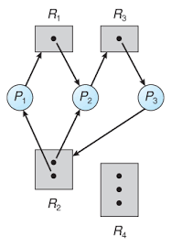
Example of resources allocation graph

Slide 10
Methods for handling deadlock
Allow the system to enter a deadlock state and then recover.
Ignore the problems and pretend that deadlock never occur in the system.

Slide 11
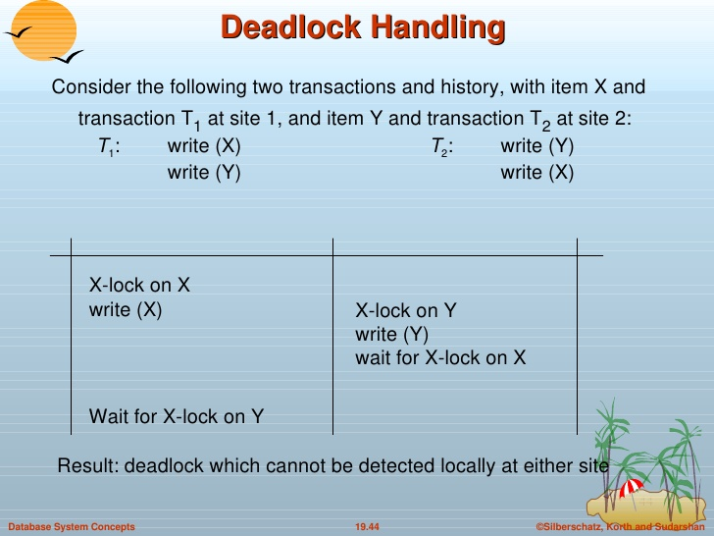
Example of deadlock handling

Slide 12
Basic facts
If a system is in safe state → no deadlock
If a system is in unsafe state → possibility of deadlock
avoidance → ensure that a system will never enter an unsafe state

Slide 13
Two phase commit protocol
What is Two phase commit protocol ?
The two phase commit protocol is distributed algorithm which lets all sites in a distributed system agree to commit a transaction.
There are two phases
Growing phase
Shrinking phase

Slide 14
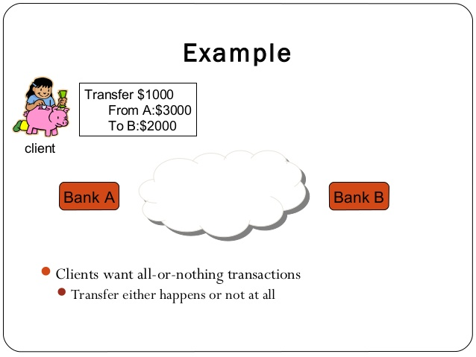
Example of two phase commit protocol

Slide 15


